Slide 1

Skin cancer detection using cnn model (DEEP LEARNING)
Batch-7
Batchmates:
221FA14018-Zubedha Begam
221FA14043-Safiya
221FA14048-Yogya
221FA14057-Jagadeesh
Guide: Mrs. M. Bhargavi (Assistant professor)
Vignan’s Foundation for Science, Technology & Research

Slide 2
Problem Statement
To build a CNN based model which can accurately detect Skin diseases.
A solution which can evaluate images and alert the dermatologists about the presence of Skin diseases has the potential to reduce a lot of manual effort needed in diagnosis.

Slide 3
Model Architecture
The CNN model used in this project consists of several convolutional and pooling layers, followed by fully connected layers. The model was trained to classify the three different types of skin cancer present in the dataset. Data augmentation techniques, such as random flipping, rotation, and zoom, were applied to handle class imbalances and improve model performance.

Slide 4
Methodology:
To build a CNN-based model for skin disease detection, first, collect and preprocess a large dataset of labeled skin disease images, resizing and normalizing them for consistency.
Data augmentation can enhance model generalization. Design a CNN with convolutional, pooling, and fully connected layers for feature extraction and classification, using SoftMax activation for multi-class classification of diseases like actinic keratosis and melanoma.
Compile the model with an appropriate loss function and optimizer , then train it using training data with early stopping and data augmentation.
Evaluate performance on a test set using accuracy, precision, recall, and a confusion matrix, and fine-tune the model or use transfer learning if needed.
Finally, deploy the model in a clinical environment, allowing dermatologists to upload images for automatic diagnosis, and monitor the model’s performance with new data, ensuring fairness and addressing potential biases through diverse training data.

Slide 5
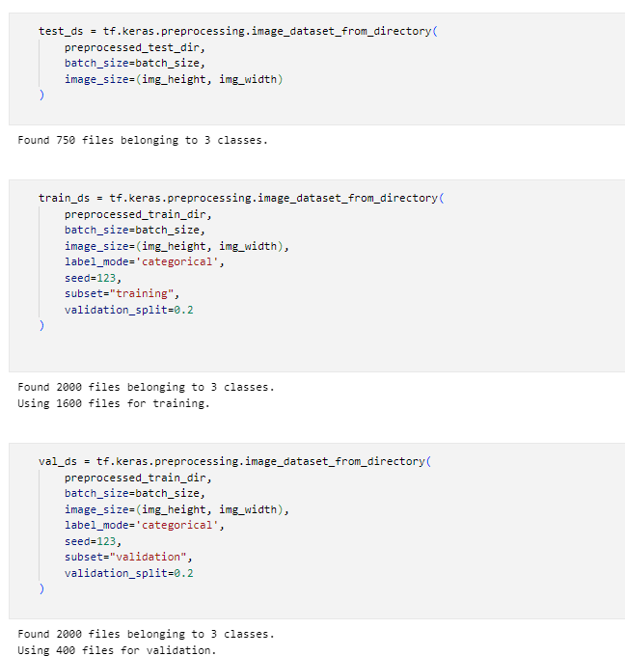
CNN MODEL:
In cnn model the dataset has 2000 images in 3 classes in which 1600
for training and 400 for validation and 750 for the testing

Slide 6
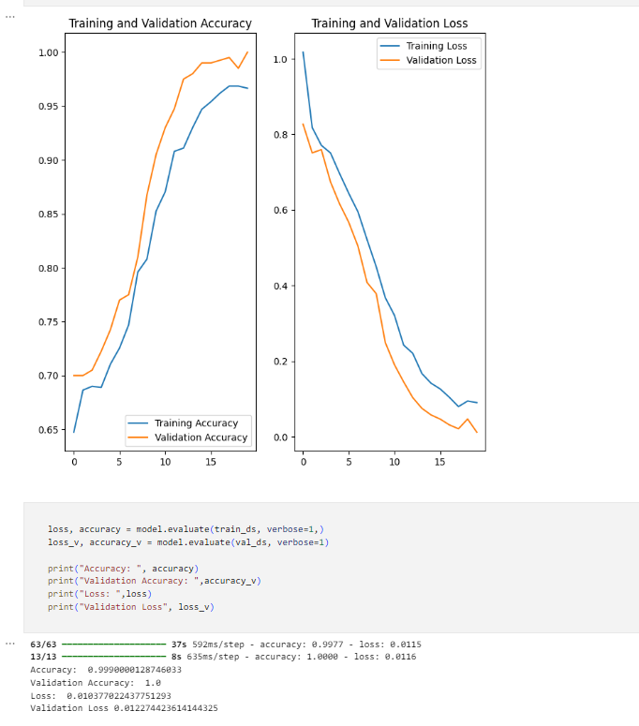
For 20 epochs:

Slide 7
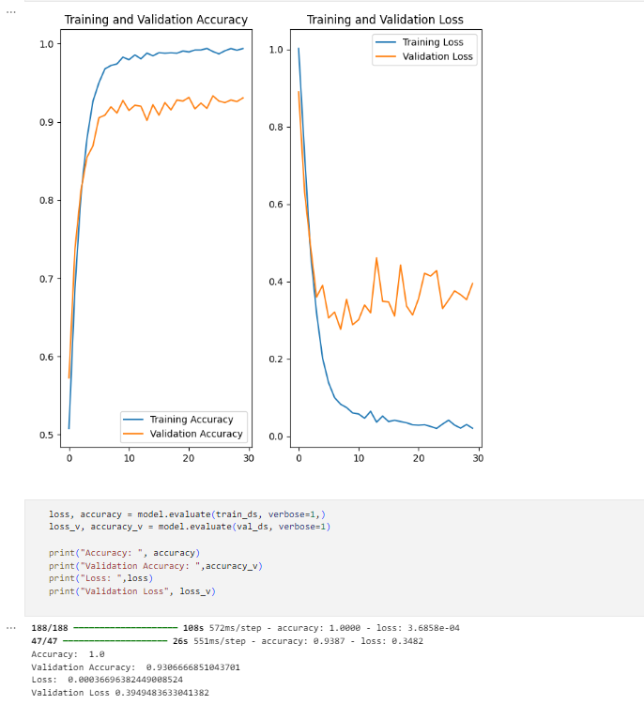
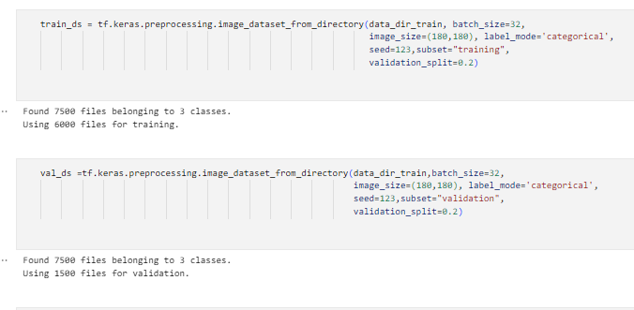
After aggumenting the images to 2500 in each class we increased the accutacy to the 93%

Slide 8
Models in CNN
Our initial CNN model did not achieve the desired accuracy.
To improve performance, we are implementing VGG19 and ResNet models.
These models provide better feature extraction and higher classification accuracy for skin disease detection.
VGG19 Model
It is a deep learning model used for image classification.
It has 19 layers that help recognize patterns in images.
If not fine-tuned, it can overfit
ResNet:
ResNet (Residual Network) is a deep learning model designed to train very deep networks effectively.
This improves training efficiency and makes ResNet more accurate than traditional CNNs.
It is widely used in medical image classification, with versions like ResNet-50 and ResNet-101 for better feature learning.

Slide 9
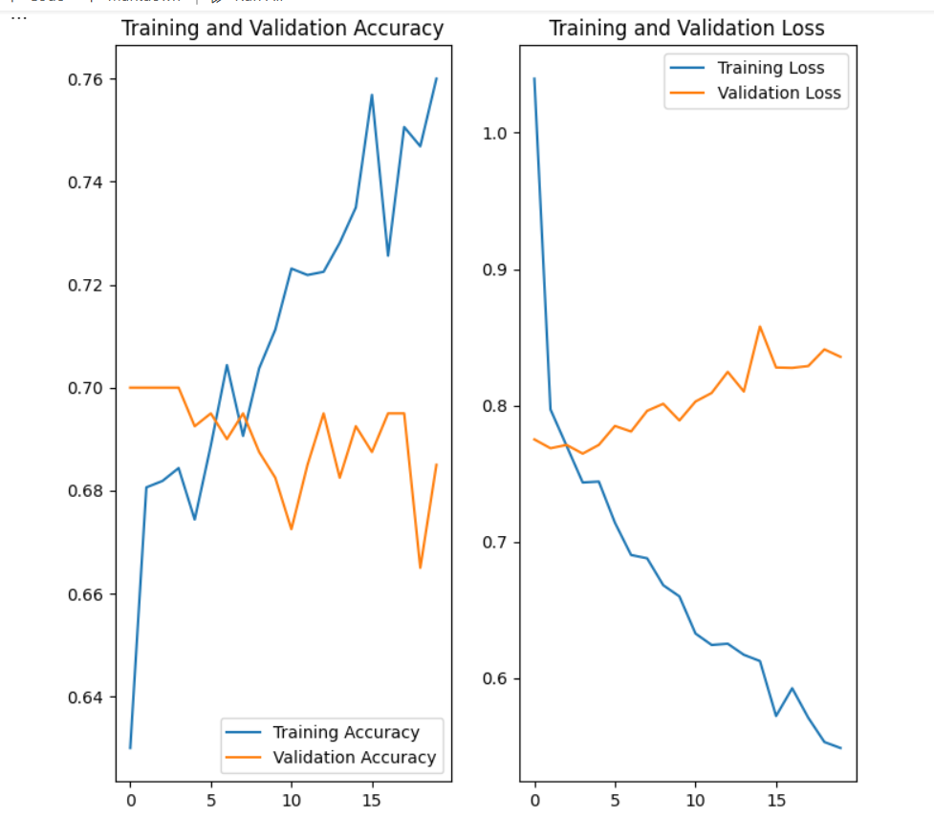
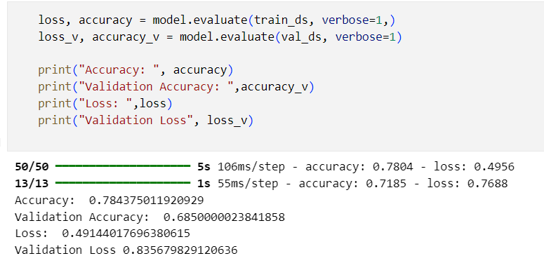
ResNet50
The model uses ResNet50 as a frozen backbone for feature extraction and adds custom dense layers for a 9-class classification task.
This design is optimized for transfer learning, focusing training on the customized top layers while retaining the learned features from ResNet50.

Slide 10
Overfitting of images:
Overfitting is when a model learns the training data too well, including noise, causing poor generalization to new data . Some methods to solve overfitting:
Dropout layer-Regularization.
L1/L2 regulation- L1 and L2 regularization are techniques used to prevent overfitting by adding a penalty to the model’s loss function, discouraging overly complex models.
Early Stopping → Prevention
Batch Normalization → Stabilization
K-Fold Cross Validation → Validation
Data Augmentation → Expansion
Reduce ML/DL Complexity → Optimization

Slide 11
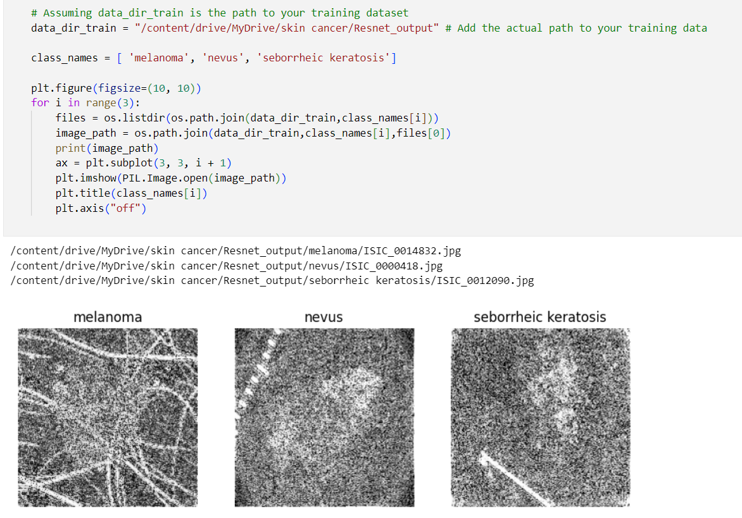
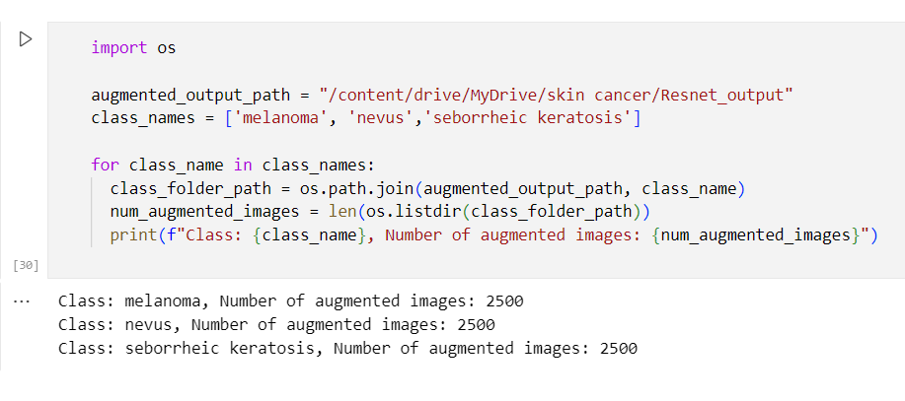
The two codes are designed to manage image counts for a skin disease detection project, but they differ in scope and functionality.
The first code checks all classes in the output folder, ensuring no class exceeds 2500 images, removing excess if necessary, but it does not perform augmentation itself.

Slide 12
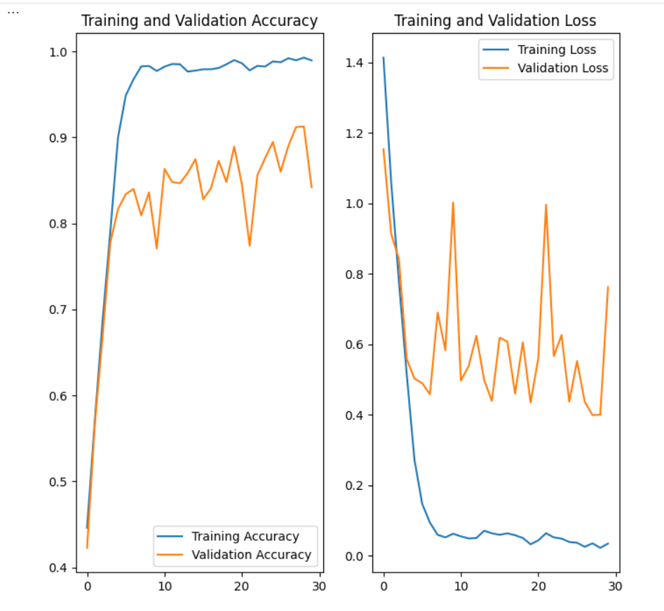
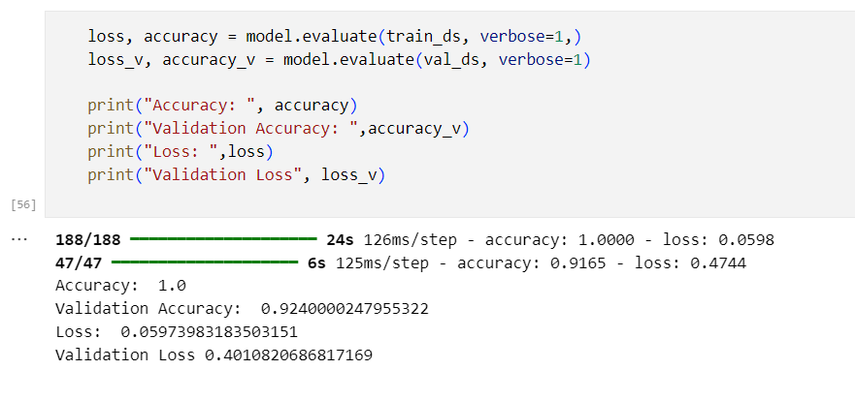
After aggumentation we got accuracy of 92%for 30 epochs

Slide 13
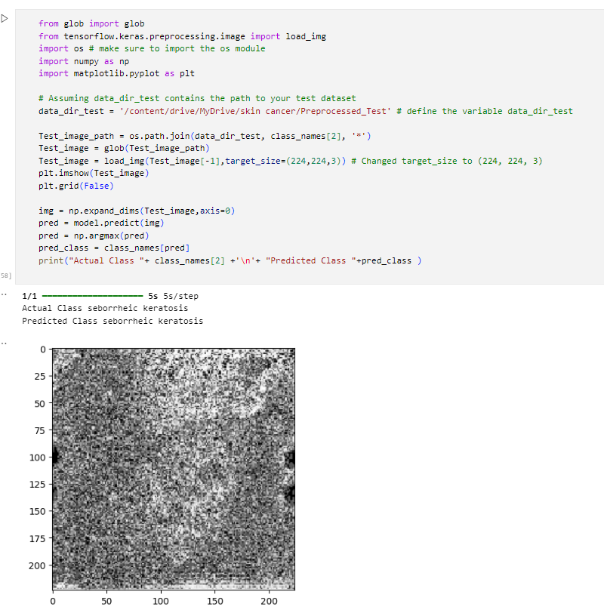
Final output:

Slide 14
VGG -19
Validation Accuracy: 96.26%
Lower than training accuracy, indicating overfitting.
Model performs well on training data but struggles with unseen data.
Techniques like dropout, data augmentation, and regularization can help improve validation accuracy.

Slide 15
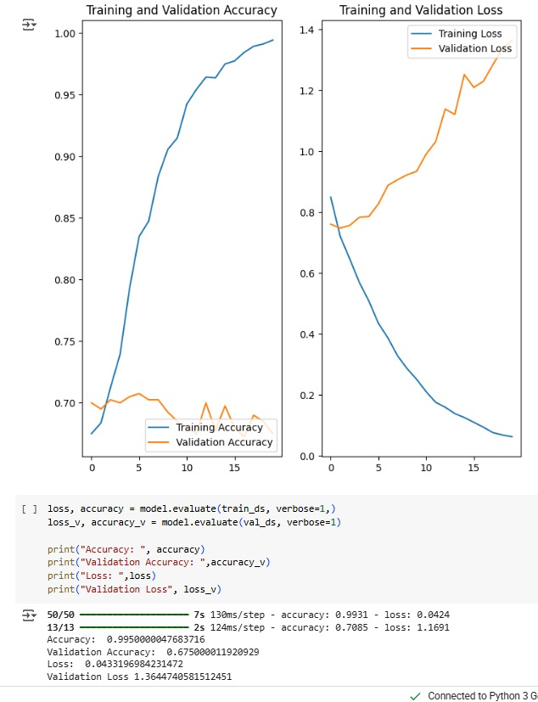
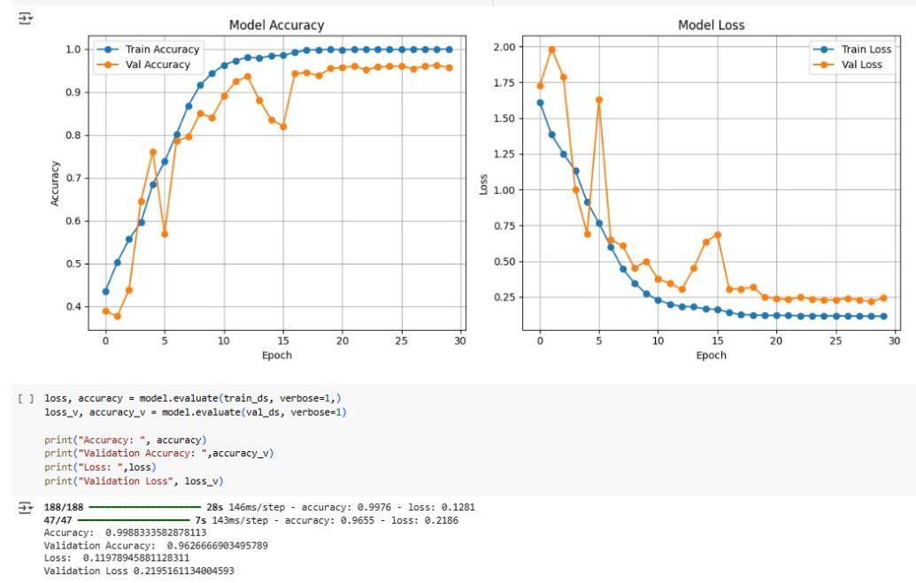
As we got the highest accuracy 96.26% than other models that we had tried till now

Slide 16
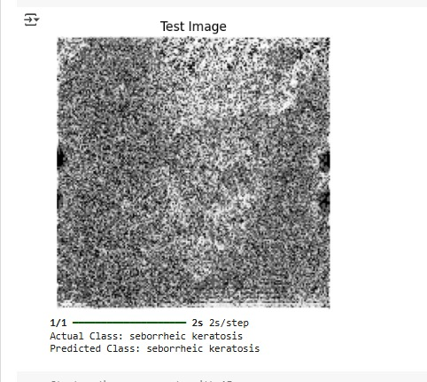
Results:

Slide 17
Conclusion
We compared CNN, ResNet50, and VGG16 models for skin cancer classification before and after data augmentation. Before augmentation, all models showed signs of overfitting with lower validation accuracy. After augmentation, performance improved significantly, especially for VGG16, which achieved the highest validation accuracy and most accurate predictions on test images. ResNet50 also performed well, while the custom CNN showed more results. Overall, VGG16 with data augmentation proved to be the most effective and reliable model for this task.

Slide 18
References:
1. Bhargavi, Maridu, Syed Shareefunnisa, Sk Sajida Sultana, R. Renugadevi, Talari Niteesh Varshan, and Kamisetty Ramanjaneyulu. "Deep Learning for Skin Cancer Classification: Leveraging Feature Extraction and Transfer Learning Strategies." In 2024 8th International Conference on Inventive Systems and Control (ICISC), pp. 181-188. IEEE, 2024.
2. Bhargavi, Maridu, and Sivadi Balakrishna. "Probing Skin Cancer Awareness: Insights in to Classification Approaches." In 2024 International Conference on Advances in Computing, Communication and Applied Informatics (ACCAI), pp. 1-6. IEEE, 2024.
3. Renugadevi, R., Maridu Bhargavi, and Sivadi Balakrishna. "Classifying Skin Lesions: A Survey of Approaches in Skin Cancer Diagnosis." In 2024 4th International Conference on Pervasive Computing and Social Networking (ICPCSN), pp. 264-269. IEEE, 2024.
4. Bhargavi, Maridu, and Sivadi Balakrishna. "An Efficient Skin Cancer Classification System Using Deep CNN." In 2023 9th International Conference on Smart Structures and Systems (ICSSS), pp. 1-5. IEEE, 2023.

Slide 19
Thank you

